Slide 1
M5 Forecasting
Group 2
Luigi Montaleone student n. 189595
Simone Mungari student n. 190042
Matteo Loria student n. 189543
Matteo Notaro student n. 189513

Slide 2
Goals of the project
Implement loading with SQOOP in Hbase or Hive
Apply map-reduce preprocessing
Implement the solution in hadoop o spark

Slide 3
Sqoop, Hbase and MySQL
We imported “calendar” and “sales” tables from a MySQL database called “challenge” into hbase:
sqoop import --connect ‘jdbc:mysql://localhost/challenge?serverTimezone=UTC&zeroDatetimeBehavior=CONVERT_TO_NULL’ --username root --P --table calendar --hbase-table calendar --column-family ‘infodays’ --hbase-row-key ‘date’ -m 1 --hbase-create-table
sqoop import --connect ‘jdbc:mysql://localhost/challenge?serverTimezone=UTC&zeroDatetimeBehavior=CONVERT_TO_NULL’ --username root --P --table sales --hbase-table sales_train_validation --column-family ‘infosales’ --hbase-row-key ‘id’ -m 1 --hbase-create-table

Slide 4
Our idea:
The main idea was to use the data from the chronological sales of each product and joining them with the info of each day (events, day of week etc.) so we could train our models to recognize patterns of growth and decrease based on external conditions.

Slide 5
MapRed and Hadoop
We used Map-Reduce algorithm to preprocess the data in two different steps:
Before the join
After the join
Before the join we used MapRed to clean the sales log from unnecessary data like department, category, state and store. We also discarded the days that weren’t:
In the same month but in different year
In the last 3 months

Slide 6
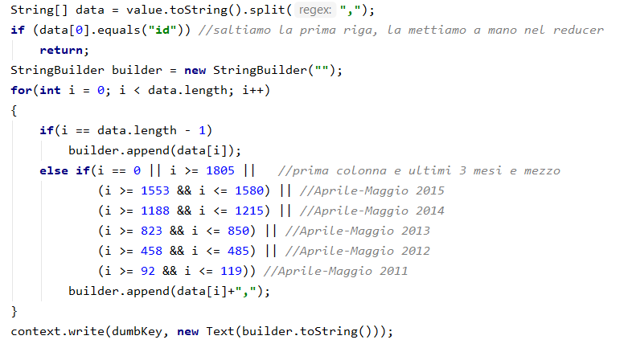
This is the mapper function:

Slide 7
We also cleared the calendar table removing all the columns exept for wm_yr_wk, weekday, d, event_type_1, event_type_2.
Then we transposed the sales table and joined it with calendar¹.
The resulting table is similar to this:
Day | Product1 | Product2 | ... | ProductN | event_type1 | event_type2 | wday | ...
d_1 | 0 | 0 | ... | 10 | 0 | 1 | 5 | ...
d_2 | 1 | 5 | ... | 0 | 1 | 1 | 6 | ...
d_3 | 10 | 9 | ... | 3 | 0 | 0 | 1 | ...
This step has been done with Python 3.8.2 and pandas library

Slide 8
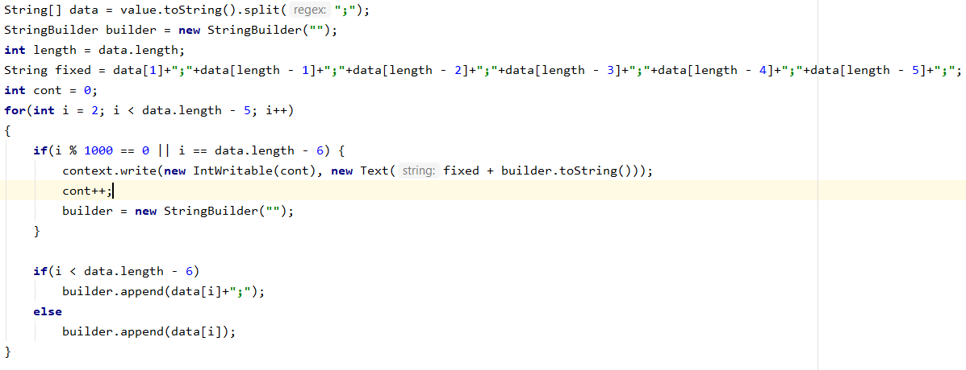
After joining the data we decided to split out the very big table (283x30000) into 30 different files so we can use it into Spark because otherwise it throwed us Memory-related exception also using .cache() and other kind of optimization.
To do so we used also MapRed. This is the mapper:

Slide 9
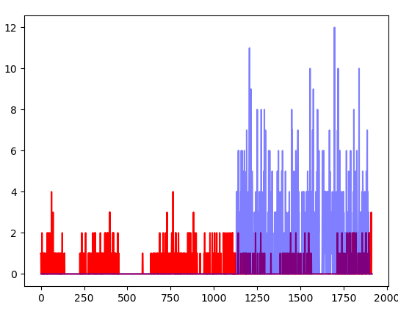
The model
We could split out the file because our idea was to have a model for every product.
This is an example of 2 products.
Using the same model to predict this
2 products could generate a very high error

Slide 10
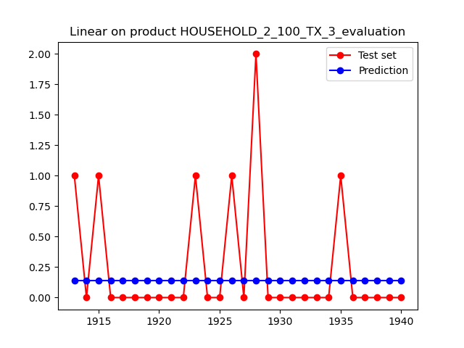
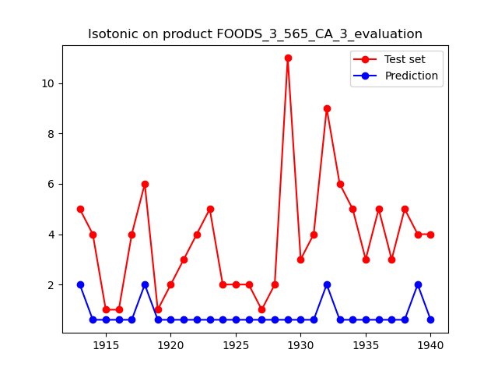
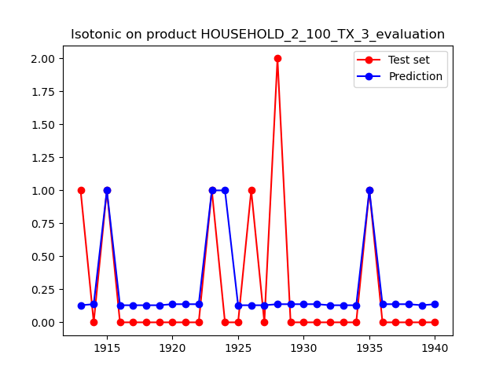
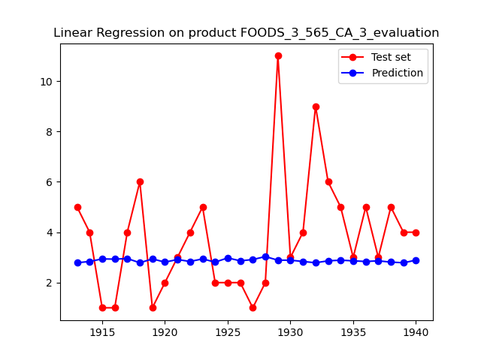
Linear regression & Isotonic regression

Slide 11
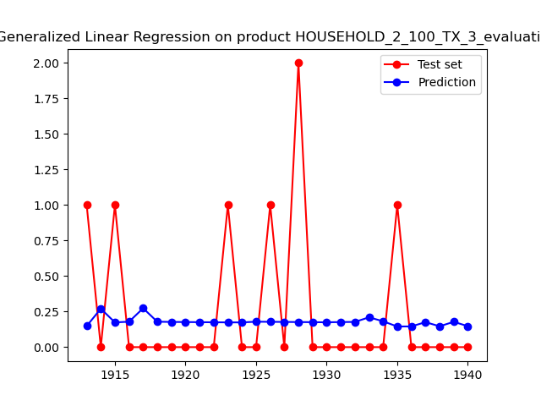
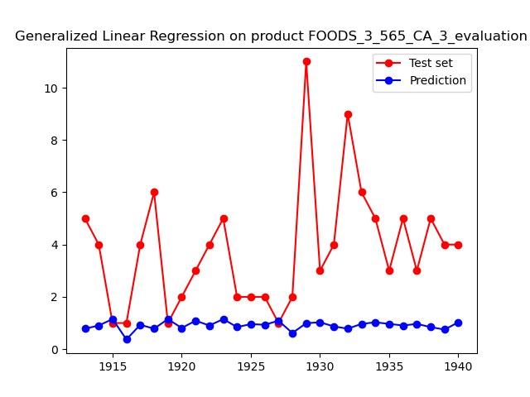
Generalized linear regression

Slide 12
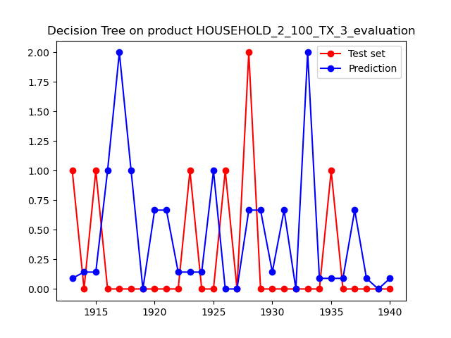
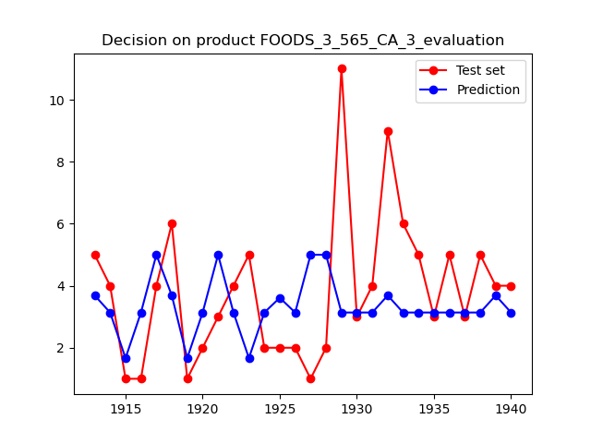
Decision Tree Regression

Slide 13
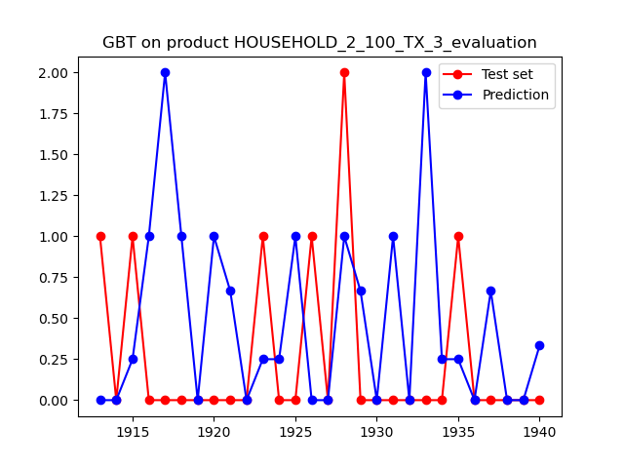
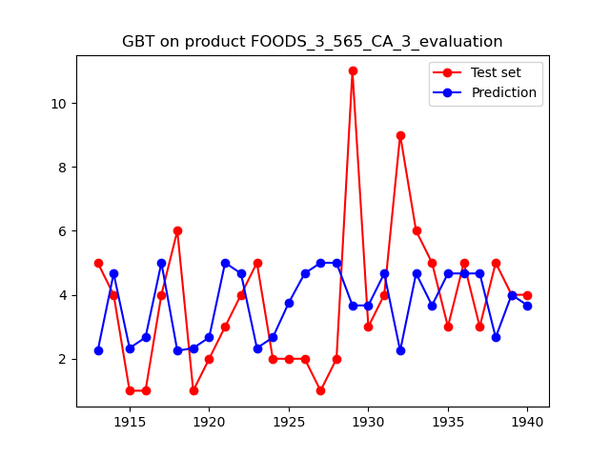
Gradient-Boosted Tree Regression

Slide 14
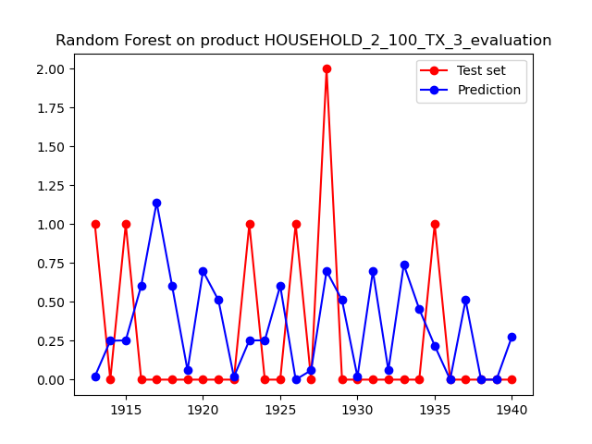
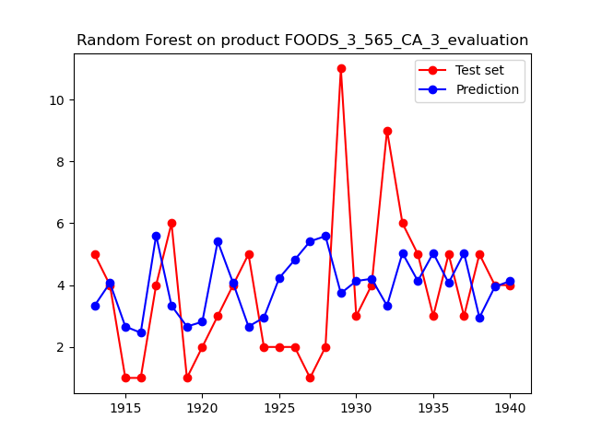
Random Forest Regression

Slide 15
Average of RMSE
 | Linear | Isotonic | Generalized | Decision Tree | GBT | Random Forest
Table11 | 2.63 | 2.76 | 2.71 | 2.6 | 2.8 | 2.64
Table30 | 1.18 | 1.22 | 1.19 | 1.24 | 1.34 | 1.24

Slide 16
Why did we exclude sell prices from computation?
Restricted range of values

Slide 17
Product | RMSE With Sell Price | RMSE Without Sell Price
FOODS_3_827_WI_3_validation | 1.58 | 1.58
FOODS_3_826_WI_3_validation | 1.33 | 1.32
FOODS_3_825_WI_3_validation | 0.94 | 0.91
FOODS_3_824_WI_3_validation | 0.61 | 0.57
FOODS_3_823_WI_3_validation | 0.93 | 0.82
FOODS_3_822_WI_3_validation | 1.42 | 1.46
FOODS_3_821_WI_3_validation | 1.27 | 1.25
FOODS_3_820_WI_3_validation | 1.23 | 1.26
FOODS_3_819_WI_3_validation | 1.84 | 1.77
FOODS_3_818_WI_3_validation | 1.52 | 1.49

Slide 18
Are we going to win the M5 Forecasting competition?
Thanks for the attention!

